Slide 1
Gorton and Metrick: Getting Up to Speed on the Financial Crisis
- Sneha Murali

Slide 2
Agenda
Overview and Timeline of the crisis
Historical Background
Opinion
The Crisis Build-up
The Panics
Policy Responses
Real Effects of the Financial Crisis

Slide 3
Overview and Timeline of the crisis
Bernanke said, “Should the safety of their investments come into question, it is easier and safer to withdraw funds—‘run on the bank’ —than to invest time and resources to evaluate in detail whether their investment is, in fact, safe”. During the first half of 2007, problems in the subprime market became increasingly visible and included the failure of several subprime originators. And even before that there was a credit boom, steeply rising home prices, and global imbalances in foreign trade.
Triggers
Losses and Prospective losses on subprime mortgages (not large enough to explain the crisis though)
Vulnerabilities
Shadow Banking, large and unregulated
Short-term debt, mainly repos and commercial paper

Slide 4
Overview and Timeline of the crisis
Disruptions in the US market created a shortage of US dollars in the global market – problems in rolling over short-term funding of long-term US assets, shortage of US dollars in the foreign exchange swap market
The bankruptcy of Lehman of September 15, 2008 led to a run on money market mutual funds after one large fund “broke the buck”
The resulting turmoil led to banks hoarding liquidity, and this will play an important role in transmitting the crisis to the real sector and internationally
US Congress passed the Troubled Asset Relief Program (TARP)
Signs of stabilization from mid-March 2009

Slide 5
Historical Background
Reinhart and Rogoff (2011) and Schularick and Taylor (forthcoming) identify debt as the key antecedent to banking crises. While Reinhart and Rogoff focused on public and private debt, Schularick and Taylor focused on the structure of banking sector and conducted new data series based analysis to identify the patterns of financial crises.
Reinhart and Rogoff
Schularick and Taylor
External debt increases sharply in advance of banking crises
Banking crises tend to lead sovereign-debt crises
140-year panel data for 14 countries consisting of aggregate credit, bank assets and broad money aggregates (M2/M3)
Post WWII, credit started to decouple from broad money and grew rapidly, via a combination of increased leverage and augmented funding via the nonmonetary liabilities of banks
Changes in credit supply are a strong predictor of financial crises

Slide 6
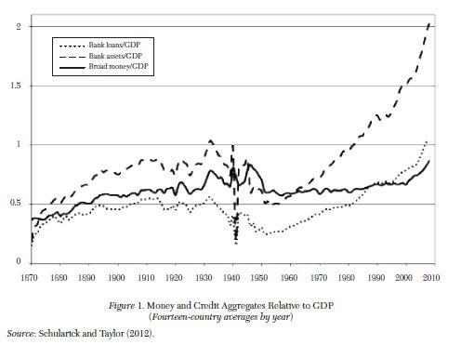
Historical Background

Slide 7
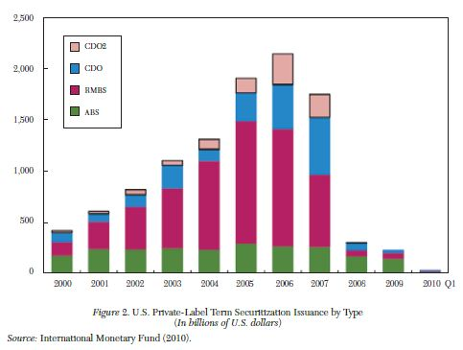
Crisis Build-up
As discussed, crises are preceded by credit booms. In the 2008 financial crisis, the credit boom took the form of asset-backed securities, particularly mortgage-backed securities.
There was an explosive growth in securitization in the six or seven years before the crisis. The private-label securitization market grew from under $500 billion in issuance to over $2 trillion in issuance in 2006, the year before the crisis.

Slide 8
Crisis Build-up
The growth in securitization was caused by the growth in institutional cash pools. Institutional cash pools are large (typically at least $1 billion in size) and centrally managed. Pozsar documents a striking rise in the funds managed by these pools, from about $200 million in 1990 to nearly $4 trillion on the eve of the crisis.
The key point about the growth of institutional cash pools is that they have an associated demand for liquidity and “safe” assets. But there were not enough “safe” assets, US Treasuries, for the pools to hold. The demand for “safe” assets by institutional cash pools exceeded the outstanding amount of short-term government guaranteed instruments not held by foreign official investors by a cumulative of at least $1.5 trillion; the ‘shadow’ banking system rose to fill this gap”.
The substitutes to US Treasuries were of two forms: repos and asset-backed commercial paper that provided collateral and unsecured money market mutual funds. This led to a growth of the shadow-banking system.

Slide 9
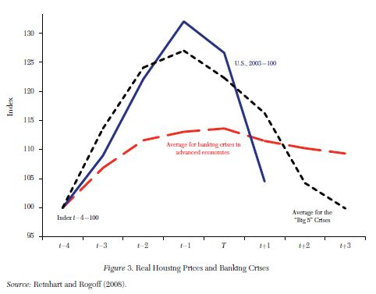
Crisis Build-up: Housing Prices
Mortgages were the preferred collateral for private asset-backed securities. In credit booms, housing prices are known to rise. So was the 2008 housing price increase a bubble?
Case and Schiller think of a bubble as “a situation in which excessive public expectations of future price increases cause prices to be temporarily elevated” and their research proves that housing prices were consistent with a bubble. Reinhart and Rogoff (2008) also shows that house price run-ups prior to crises are common.

Slide 10
The Panics
By July 2007, there was approximately $1.2 trillion of Asset-backed Commercial Paper ABCP outstanding, with the majority of this paper held by MMFs. Two main panic periods: August 2007 and September–October 2008.
ABCP program would suffer a “run” if lenders—equivalent to depositors in a bank—are unwilling to refinance CP when it comes due.
ABCPs were likely to face a “run” if they had high credit risk (from likely exposure to subprime-related securities) or high liquidity risk (from missing or incomplete liquidity support). But importantly, there was also a high level of run activity unrelated to program-specific measures. Taken together, the evidence indicates that vulnerability to runs is strongly related to fundamentals, but investors are uncertain about which programs are weaker.
Overall, the ABCP market fell by $350 billion in the second half of 2007. Most programs relied on backup support from their sponsors to cover this shortfall.

Slide 11
The Panics
We all know of the Reserve Primary Fund, a large MMF that “broke the buck” after the failure of Lehman in September 2008. Less well known are the struggles of MMFs in the August 2007 panic.
As a result of ABCPs facing “runs”, at least forty three MMFs required assistance from their sponsors in order to avoid breaking the buck.
The sponsor-based rescue of MMFs in 2007 prevented any runs by investors on those funds that year and solidified the expectation that MMFs would always be bailed out by their sponsors.
The Lehman bankruptcy was a major shock to MMFs. The drop from parity of the Reserve Primary Fund led to a run on similar funds.

Slide 12
The Panics: The Missing Piece
ABCP panic was driven by a weakness in subprime mortgages, whereas the eventual run on MMFs was triggered by the bankruptcy of Lehman.
Subprime failure had a direct effect on many ABCP programs, with runs that began in August 2007 eventually affecting 40 percent of that $1.2 trillion market.
These runs and related price drops in other subprime-related securities caused unprecedented problems for MMFs, where at least forty-three funds required support from their sponsors.
After the initial panic of August 2007, interbank markets were slow to recover, with spreads between secured and unsecured funding remaining at high levels throughout the next year. This pressure also manifested itself in repo markets, where haircuts grew steadily throughout the year, adding to the funding pressure on financial intermediaries.
When this pressure finally claimed Lehman Brothers as a victim, the stressed interbank markets nearly collapsed, and only recovered after significant government intervention.

Slide 13
Policy Responses
IMF (2009) analyzes the effectiveness of policy responses in thirteen developed economies. They divide the crisis into three periods: period 1 (“Pre-Lehman”), period 2 (“Global Crisis 1”), period 3 (“Global Crisis 2”). In each of these three periods, they employ event-study methodology to measure the impact of five different kinds of policy actions.
To evaluate the efficacy of interest rate cuts, the IMF looked at the short-term reaction of both an “economic stress index” (ESI) and a “financial stress index” (FSI). The ESI is a composite of confidence measures (business and consumer), credit spreads, and stock prices of nonfinancial companies. The FSI is a composite of several measures of bank credit, spreads, and stock prices.
Overall, the evidence suggests that liquidity support—in the forms described in table 2—was effective at calming interbank credit markets in the early stages of the crisis, but not after the fall of Lehman. In these later stages, capital injections were the most effective policy.

Slide 14
Real Effects of the Financial Crisis
Evidence shows that banks reduced the supply of credit during the financial crisis.
The evidence suggests that banks cut back on credit supply, although the demand for credit also fell. The resulting reduction in credit supply had significant impacts on credit-constrained firms.

Slide 15
Opinions
Gorton and Metrick’s paper is a great read for those looking to learn about the financial crisis. Their paper consolidates research published in 16 documents
The paper does not talk about what led to the weakness in the subprime market
Unregulated shadow banking seems like a key factor in the happenings that led to the crisis
More research is required to identify predictors for crises, and the direction of causality between credit booms and crises

